Slide 1
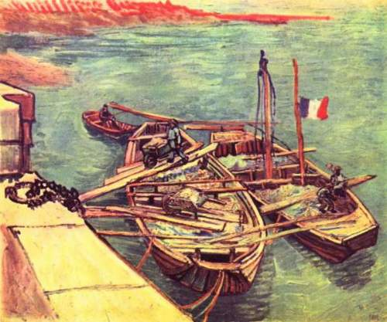
Functions and Onto
Boats with Sand Van Gogh
Discrete Structures (CS 173)
Madhusudan Parthasarathy, University of Illinois

Slide 2
Administrative
Midterm-1 Exam next Tuesday in class
Materials to help you prepare:
Skills list: detailed list of things you could be tested on
Mock midterm exam with solutions
Review notes (concise notes of things you have learnt so far)
Honors homework available online
Some office hours next week will be moved from Tues/Wed to Sun/Mon
will post times on piazza

Slide 3
Last class: relations
Irreflexive, Antisymmetric
Reflexive
Symmetric
Not Transitive
Transitive
Vacuous truth

Slide 4
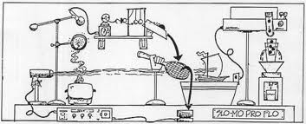
Today’s class: functions
What is a function, and what is not?
Identify which functions are “onto”
Nested quantifiers
Mixing “for all” and “there exists”
Composing functions

Slide 5
What is a function?
Function: maps each input element to exactly one output element
Every function has
a type signature that defines what inputs and outputs are possible
an assignment or mapping that specifies which output goes with each input
$$f:A→B such that f\left(x\right)=…$$
domain
co-domain

Slide 6

Examples of functions
Concepts: type signature, mapping; bubbles, plots
Functions: age, t-shirt color, $x^{2}$

Slide 7
What is not a function?
Not a valid function if
No type signature
Some input is not mapped to an output
Some input is mapped to two outputs

Slide 8
When are functions equal?
Functions are equal if
They have the same type signature
The mapping is the same
Equal functions may not necessarily have the same description/closed form!
Notes:
Examples: N->N, x; N->N, |x|; R->R, x; R->R, |x|; R->R, if x<0, -x; else x.

Slide 9
Onto
image: set of values produced when a function is applied to all inputs
onto: the image is the co-domain (every possible output is assigned to at least one input)
$$f:A→B, ∀y∈B, ∃x∈A, such that f\left(x\right)=y$$
Notes:
Examples: Z to Z, 2x; Z to evens, 2x;

Slide 10
Proof of onto
Claim: $f:R→R , f\left(x\right)=x+1$ is onto.
Definition: $f:A→B, f(x)$ is onto iff $∀y∈B, ∃x∈A, such that f\left(x\right)=y$

Slide 11
Proof of onto
Claim: $f:N2→Z , f\left(x,y\right)=x−y$ is onto.
Definition: $f:A→B, f(x)$ is onto iff $∀y∈B, ∃x∈A, such that f\left(x\right)=y$

Slide 12
Onto functions to a finite set
Let f: A -> B and B have n elements.
How many elements can A have?
- Less than n?
- Equal to n?
- Greater than n but finite?
- Infinite?

Slide 13

Can there be an onto function from $N$ to $Z$ ?!
$$f:N →Z$$
$$f\left(x\right)=\frac{x}{2} if x is even$$ $=−\frac{x+1}{2}$ if x is odd
0 -> 0 1->-1 2->1 3-> -2 4-> 2 …

Slide 14
Nested quantifiers
There is a pencil for every student.
Every student is using the same pencil.
For a function $f:R→R, f\left(x\right)=x^{2}$, for every output element, there is at least one input element.
There exists an $x∈R,$ such that for every $y∈R$, $y=x^2$
There exists an $y∈R,$ such that for every $x∈R$, $y=x^2$
For every $x∈R,$ there exists a $y∈R$, such that $y=x^2$
For every $y∈R,$ there exists a $x∈R$, such that $y=x^2$

Slide 15
Nested quantifiers
There is a pencil for every student.
Every student is using the same pencil.
For a function $f:R→R, f\left(x\right)=x^{2}$, every output element is assigned to at least one input element.
For a function $f:A→B$, there is one output that is assigned to every input.

Slide 16

Nested quantifiers
There exists an $x∈R,$ such that for every $y∈R$, $y=x^2$
There exists an $y∈R,$ such that for every $x∈R$, $y=x^2$
For every $x∈R,$ there exists a $y∈R$, such that $y=x^2$
For every $y∈R,$ there exists a $x∈R$, such that $y=x^2$

Slide 17
Negation with nested quantifiers
It’s not true that there is a pencil for every student.
No student has any pencil.
There is one pencil that no student has.
onto: $f:A→B, ∀y∈B, ∃x∈A, such that f\left(x\right)=y$
not onto:

Slide 18
Disproof of onto
Disprove: $f:N→N , f\left(x\right)=x+2$ is onto.
Definition: $f:A→B, f(x)$ is onto iff $∀y∈B, ∃x∈A, such that f\left(x\right)=y$
Notes:
Note that second case is often more useful

Slide 19

Composition
$$for g:A→B, f:B→C, (f∘g)\left(x\right)=f\left(g\left(x\right)\right)$$
$$for f:A→B, g:B→C, (g∘f)\left(x\right)=g(f\left(x\right))$$
What is wrong with
$for f:A→B, g:A→B, (g∘f)\left(x\right)=g(f\left(x\right))$”

Slide 20

Proof with composition
Claim: For sets $A,B, C and functions f:A→B , g:B→C$, if $f and g$ are onto, then $g∘f$ is also onto.
Definition: $f:A→B, f(x)$ is onto iff $∀y∈B, ∃x∈A, such that f\left(x\right)=y$
Notes:
Note that second case is often more useful

Slide 21
Things to remember
A function must have a type signature and a mapping
A valid function must have exactly one output for each input (two inputs can be assigned the same output)
For two functions to be equal, both the type signature and the assignment must be the same
A function is onto iff every output element is assigned at least once.
With proofs remember:
First, take time to understand the hypothesis and conclusion
Then, translate into a clear mathematical expression.
Then, work backwards and forwards to make hypothesis reach conclusion.
Finally, write it all out in logical order from hypothesis to conclusion.

Slide 22
See you Thursday!
One-to-one functions, bijection, permutation

